Slide 1

Detecting Arbitrage in European Options
Peter Kinder

Slide 2
Stock Options
Call Option
The right to BUY a stock for the STRIKE PRICE
BUY if you think:
SELL if you think:
Put Option
The right to SELL a stock for the STRIKE PRICE
BUY if you think:
SELL if you think:

Slide 3
Expiration Date
American Option
Exercise AT or BEFORE the expiration date
More expensive
Harder to detect arbitrage
European Option
Exercise ONLY AT the expiration date
Less expensive
Easier to detect arbitrage

Slide 4
Call Option $100 Strike & $1 Premium
Long (Buy)
Short (Sell)
Profit
Price
Price
Unlimited Upside
Unlimited Downside

Slide 5
Put Option $100 Strike & $1 Premium
Long (Buy)
Short (Sell)
Profit
Price
Price
Limited Upside
Limited Downside

Slide 6
Options Strategies Box Spread
LONG: $100 Strike & $1.00 Premium
SHORT: $105 Strike & $0.75 Premium
Profit
Price

Slide 7
Arbitrage Opportunity Box Spread
LONG: $100 Strike & $1.00 Premium
SHORT: $105 Strike & $1.25 Premium
Profit
Price

Slide 8
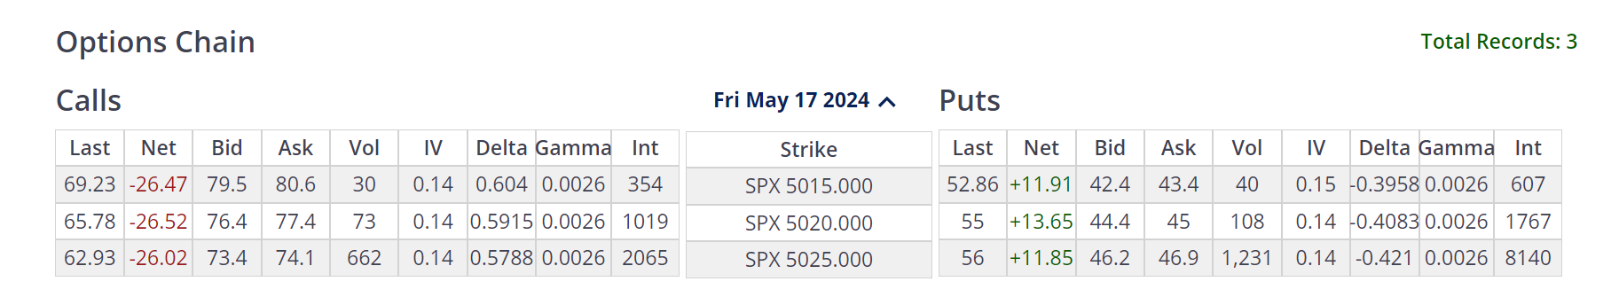
Options Chain: SPX
Short (Sell) at the Bid
Long (Buy) at the Ask
Source https://www.cboe.com/delayed_quotes/spx/quote_table

Slide 9
Optimization Problem High Level
Minimize the cost function
A negative cost is a profit
Bounded strategy over state space is non-negative
Differences between strikes and states
Bounded = No Arbitrage
Unbounded = Arbitrage
Impose additional bounds to determine

Slide 10
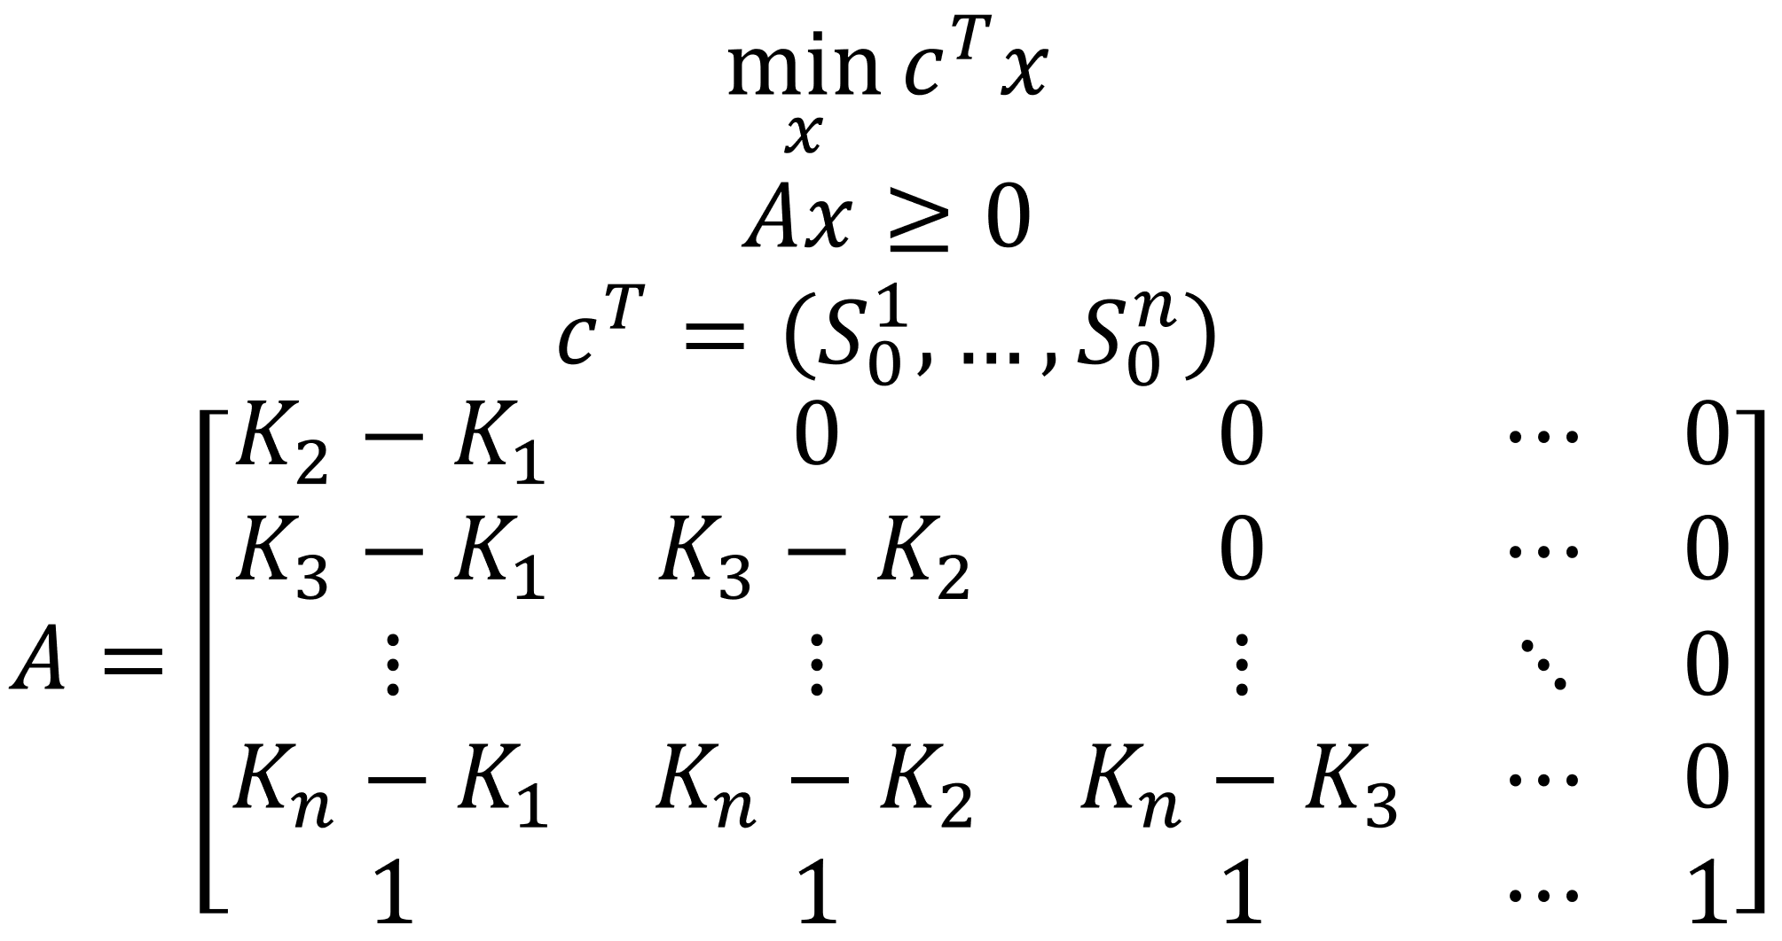
Long Call Option Setup
S = Ask Price, K = Strike Price, Rows = States, Cols = Contracts

Slide 11
Call Option Payout Slope
LONG 1 Call Contract: $100 Strike
LONG 1 Call Contract: $102 Strike
SHORT 2 Call Contract: $104 Strike
Profit
Price

Slide 12
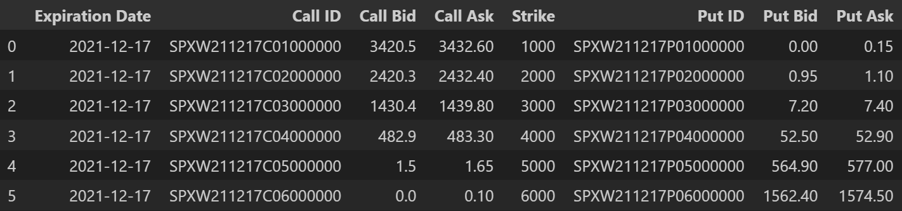
Simple No Arbitrage
Option Chain

Slide 13
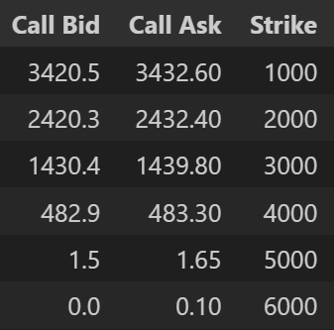
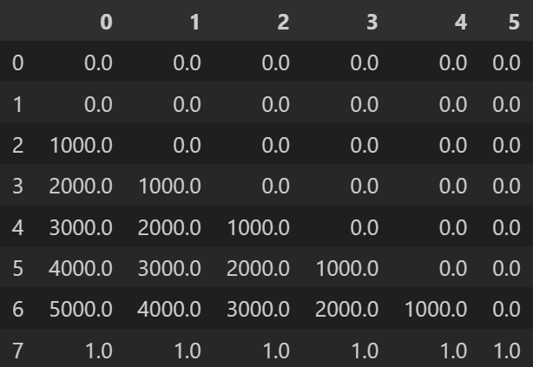
Simple No Arbitrage Long Call
Option Chain
A Matrix Portion

Slide 14
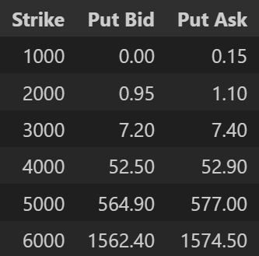
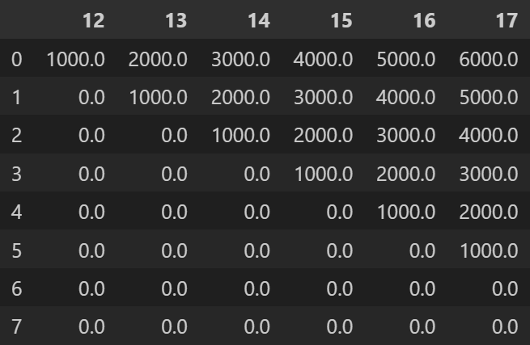
Simple No Arbitrage Long Put
Option Chain
A Matrix Portion

Slide 15
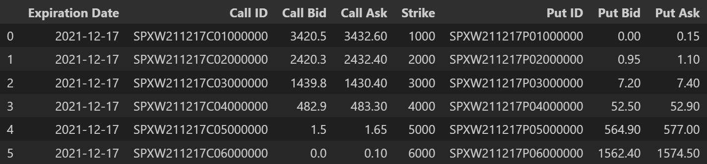
Super Simple Arbitrage
Option Chain

Slide 16
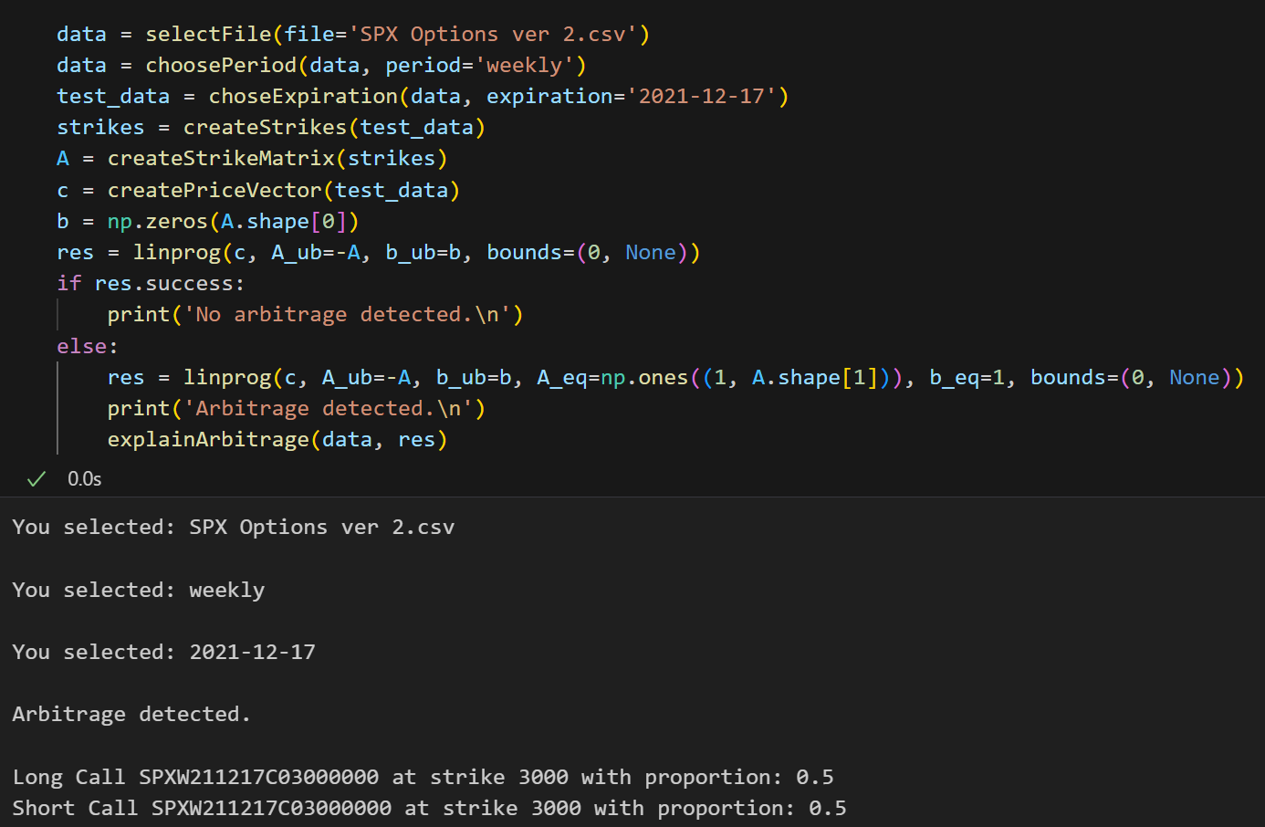
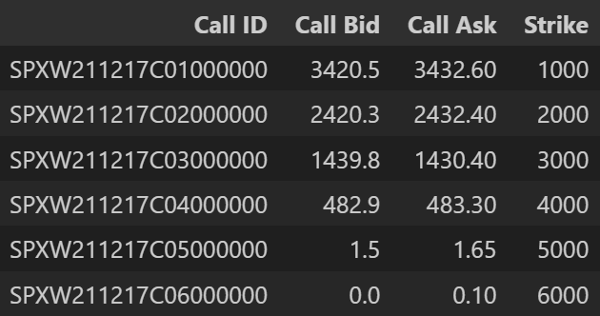
Super Simple Arbitrage
Option Chain
Decision Variables Sum to 1 Constraint

Slide 17
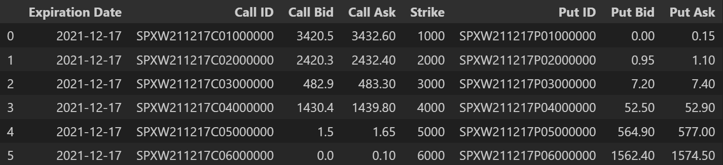
Simple Arbitrage
Option Chain

Slide 18
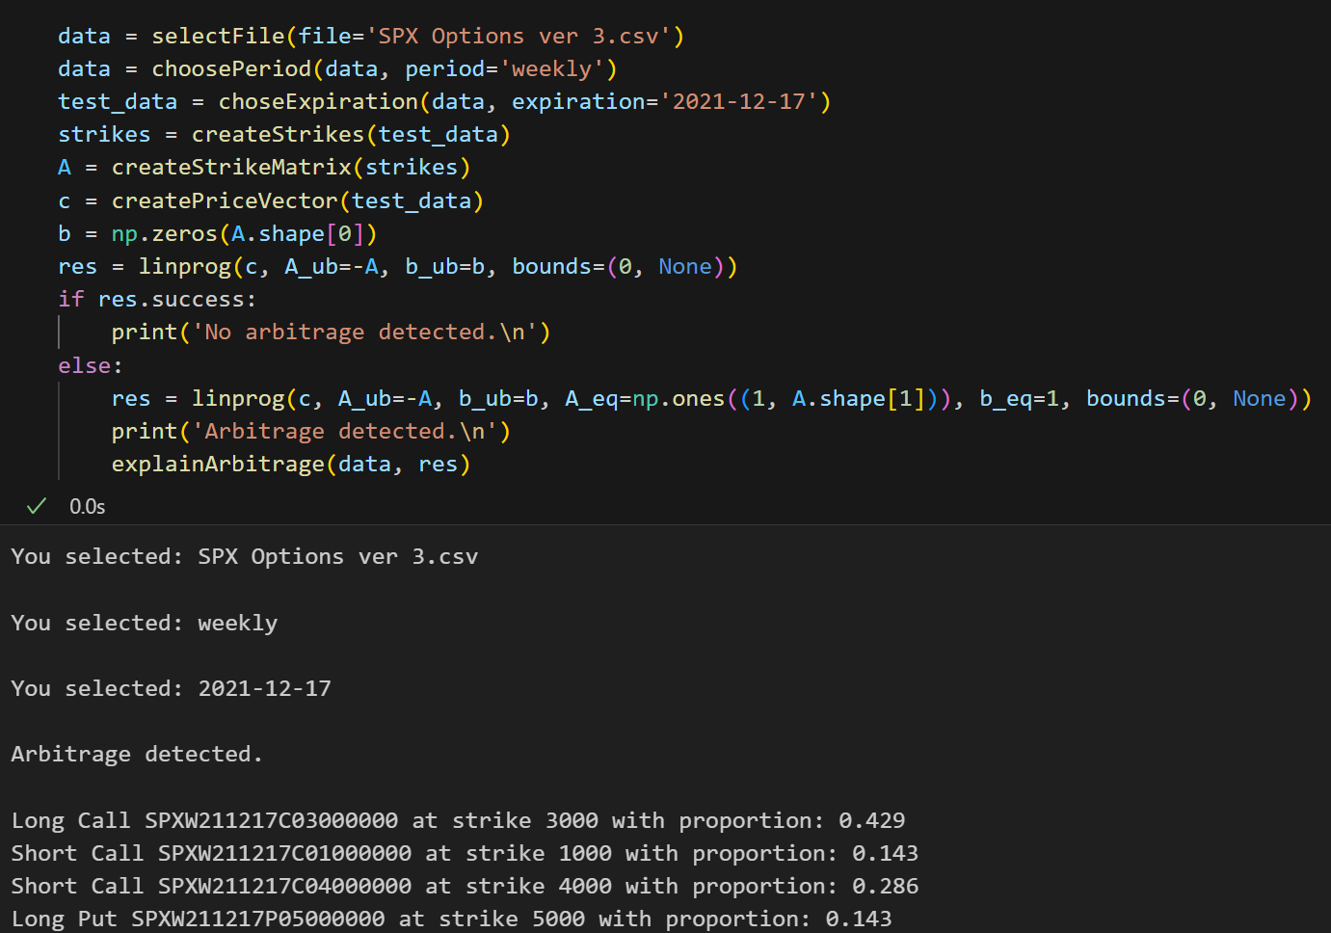
Simple Arbitrage

Slide 19
Simple Arbitrage
LONG 0.429 Call Contract: $3000 Strike
SHORT 0.142 Call Contract: $1000 Strike
SHORT 0.286 Call Contract: $4000 Strike
Profit
Price

Slide 20

Complex Arbitrage
Option Chain

Slide 21
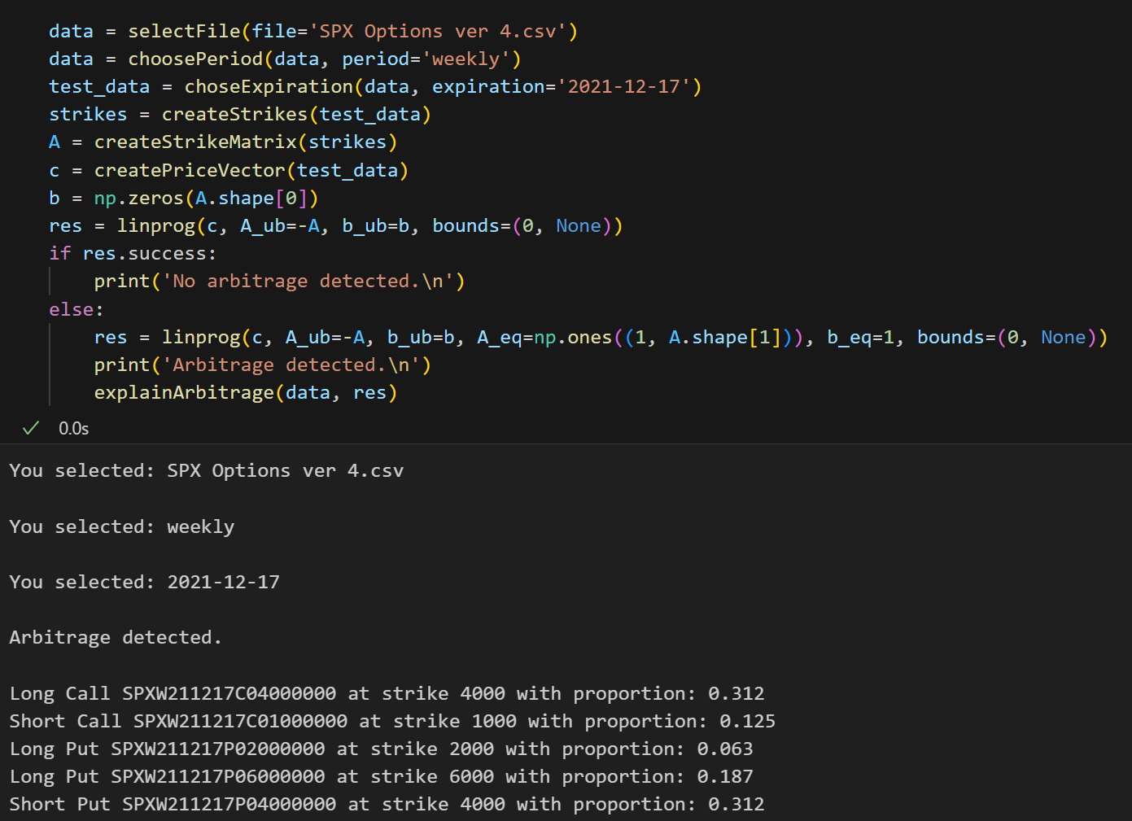
Complex Arbitrage

Slide 22
Complex Arbitrage Guaranteed $16.38 Profit
Price

Slide 23
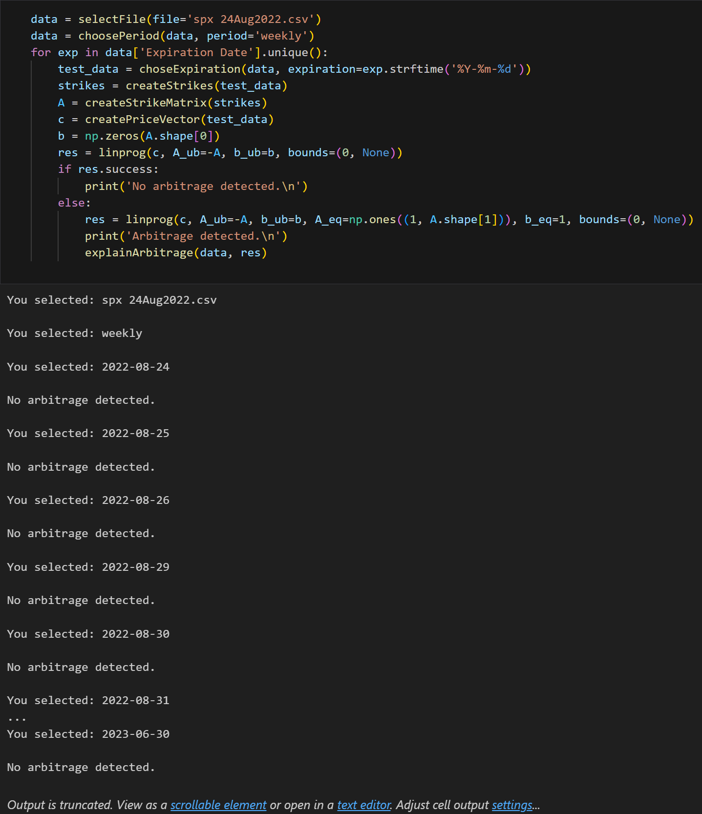
Detecting Arbitrage in SPX

Slide 24
Closing Remarks

